Slide 1
Intro to Dynamic Programming (DP)
Presented by Alex Li

Slide 2
What is DP?
Solving a problem by first making it harder.
Notes:
Better would be ‘solving a problem with recursion, saving state. But that’s later.

Slide 3
A classical conundrum
You can only go RIGHT or UP. How many ways are there to get from START to
EVERY OTHER SQUARE?
END?
 |  |  |  |  | END
START

Slide 4
A classical conundrum
You can only go RIGHT or UP. How many ways are there to get from START to EVERY OTHER SQUARE?
1 | 5 | 15
1 | 4 | 10
1 | 3 | 6 | 10 | 15 | 21
1 | 2 | 3 | 4 | 5 | 6
START | 1 | 1 | 1 | 1 | 1
Notes:
(Fill in the numbers on this slide)

Slide 5
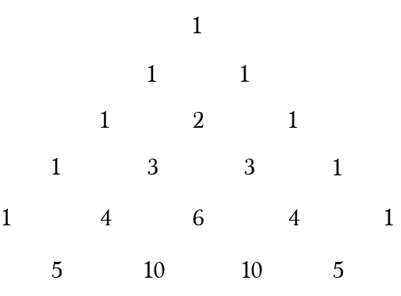
The antihero - STATIC PROGRAMMING!
I see Pascal’s triangle…
Answer is just
Equal to number of ways to rearrange the sequence RRRRRUUUU
Notes:
Static programming is not a real thing, it is totally made up

Slide 6
The Generalizable approach - Blockades
You can only go RIGHT or UP, but not through black squares. How many ways are there to get from START to END?
 |  |  |  |  | END
START

Slide 7
The Generalizable approach - Blockades
You can only go RIGHT or UP, but not through black squares. How many ways are there to get from START to END?
 | 3 | 6 |  | 11 | 27
 | 3 | 3 | 7 | 11 | 16
1 | 3 |  | 4 | 4 | 5
1 | 2 | 3 | 4 |  | 1
START | 1 | 1 | 1 | 1 | 1

Slide 8
The Generalizable approach - Blockades 2.0
How many ways are there to get from START to END?
END
ST

Slide 9
The Generalizable approach - Blockades 2.0
How many ways are there to get from START to END?
1
END
1
3
1

Slide 10
The Generalizable approach - Optimizing
You can only go RIGHT or UP. What’s the maximum score you can get, if your score is the sum of the squares your path crossed?
Score
+0 | +2 | 0
+3 | +1 | +4
+2 | +5 | +1
0 | +3 | +4

Slide 11
The Generalizable approach - Optimizing
You can only go RIGHT or UP. What’s the maximum score you can get, if your score is the sum of the squares your path crossed?
Best Score
Score
5
5
2 | 8
0 | 3 | 7
+0 | +2 | 0
+3 | +1 | +4
+2 | +5 | +1
0 | +3 | +4
Notes:
Fill in the table on the left - the best score you can get up to that point

Slide 12
Takeaways
If you can write a recurrence relation, then we can do DP by saving the states in a table.
Distinctways[i][j] = Distinctways[i-1][j] + Distinctways[i][j-1]
BestScore[i][j] = Score[i][j] + max(BestScore[i-1][j], BestScore[i][j-1])
Contrast to memoization

Slide 13
This looks different
Sum = 7
Compute the maximum sum subarray of an array
1 | -2 | 3 | -4 | 5 | 1 | -2 | 3
Notes:
https://codeforces.com/problemset/problem/1373/D

Slide 14
Max sum subarray
1 | -2 | 3 | -4 | 5 | 1 | -2 | 3
Best sum in the first i positions
0 | 1 | 1
How to fill in the next entry?
Not obvious, since we are extending from the array before it
Notes:
https://codeforces.com/problemset/problem/1373/D

Slide 15
Max sum subarray
1 | -2 | 3 | -4 | 5 | 1 | -2 | 3
Best sum in the first i positions
0 | 1 | 1
Best sum ending in this position
0 | 1 | -1 | 2
https://github.com/cpcosu/Weekly_Events/blob/master/Autumn%202020/2020-09-22/BestSum.cpp
Notes:
https://codeforces.com/problemset/problem/1373/D

Slide 16
Application in a problem
Reverse a subarray of this array so as to maximize the sum of the even indexed elements
1 | 7 | 3 | 4 | 7 | 6 | 2 | 9
score = 1 + 3 + 7 + 2 = 13
4 | 3 | 7 | 1 | 7 | 6 | 2 | 9
score = 4 + 7 + 7 + 2 = 20
Notes:
https://codeforces.com/problemset/problem/1373/D

Slide 17
Observations?
Reverse a subarray of this array so as to maximize the sum of the even indexed elements
1 | 7 | 3 | 4 | 7 | 6 | 2 | 9
score = 1 + 3 + 7 + 2 = 13
1 | 6 | 7 | 4 | 3 | 7 | 2 | 9
score = 1 + 7 + 3 + 2 = 13
Notes:
Only even length swaps matter

Slide 18
Reduction - Case 1
Start from an even index, end before an even index. We must maximize the subarray sum along the new array (6, 1, -1, 7).
1 | 7 | 3 | 4 | 7 | 6 | 2 | 9
score = 1 + 3 + 7 + 2 = 13
+6
+1
-1
+7
Best score 26

Slide 19
Reduction - Case 2
Start from an odd index, end before an odd index. We must maximize the subarray sum along the new array (4, -3 , 4).
1 | 7 | 3 | 4 | 7 | 6 | 2 | 9
score = 1 + 3 + 7 + 2 = 13
+4
-3
+4
Best score 18
https://github.com/cpcosu/Weekly_Events/blob/master/Autumn%202020/2020-09-22/MaxSumEvenPositions.cpp

Slide 20
A hard problem: Inversion Sum
https://atcoder.jp/contests/agc030/tasks/agc030_d
Given a sequence and a list of Q swaps, there are 2^{Q} ways to perform swaps. What’s the sum of the inversion numbers of all 2^{Q} final sequences (mod 10⁹ +7)?
A: 10, 20, 30, Swaps: (1,2) then (1,3)
Total inversion sum: 6
 | Nothing | (1,2)
Nothing | 10, 20, 30 -> 0 | 20, 10, 30 -> 1
(1,3) | 30, 20, 10 -> 3 | 30, 10, 20 -> 2
Notes:
The INVERSION number is the number of pairs i, j with i<j and a[i] > a[j]

Slide 21
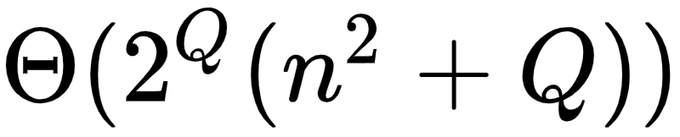
Given a sequence and a list of Q swaps, there are 2^{Q} ways to perform swaps. What’s the sum of the inversion numbers of all 2^{Q} final sequences (mod 10⁹ +7)?
Just simulate all 2^{Q} pairs of swaps, then check all pairs at the end to see if they are inverted.
Time

Slide 22
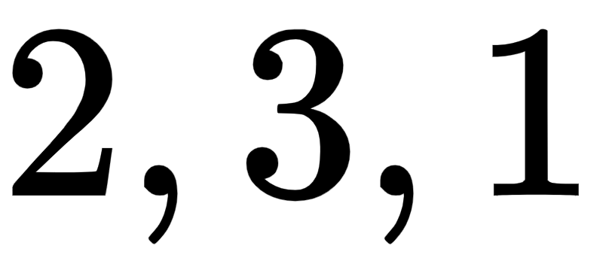
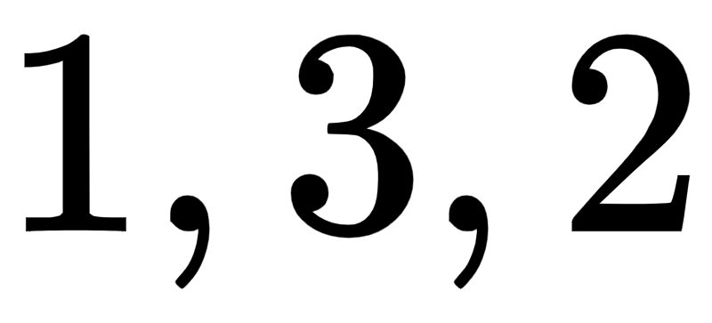
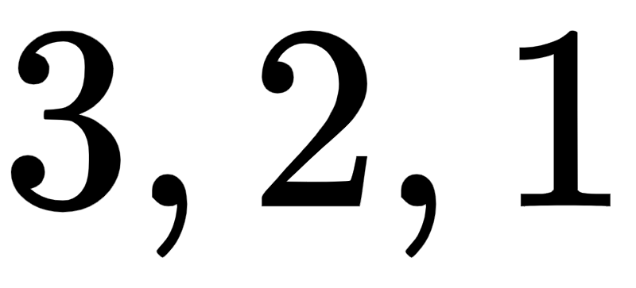
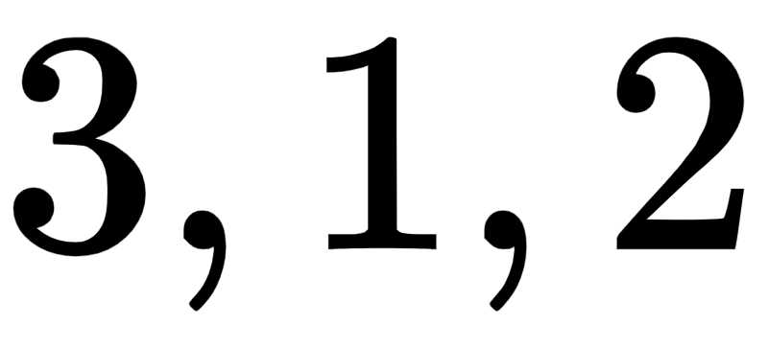
DP solution
Given a sequence and a list of Q swaps, there are 2^{Q} ways to perform swaps. What’s the sum of the inversion numbers of all 2^{Q} final sequences (mod 10⁹ +7)?
Create tables where the i^{th} row and j^{th} column in is the number of sequences where a_{i} < a_{j} after the first k operations.
We need a way to construct each table from the last one, this seems plausible.
0 | 1 | 0
0 | 0 | 0
1 | 1 | 0
0 | 2 | 1
2 | 0 | 1
3 | 3 | 0
0 | 0 | 1
0 | 0 | 2
1 | 2 | 0
Swap(1,3)
Swap(1,2)

Slide 23
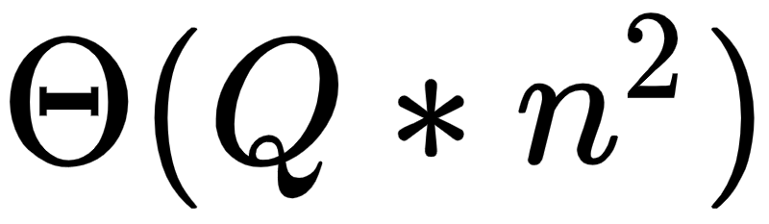
Recurrence Relation
for (int i = 0; i < n; i++)
for (int j = 0; j < n; j++)
DP[k][i][j] = DP[k-1][i][j]*2
DP[k][x][y] = DP[k][y][x] = DP[k-1][x][y] + DP[k-1][y][x];
for (int j = 0; j < n; j++) {
if (j != x && j != y) {
DP[k][j][x] = DP[k][j][y] = DP[k-1][j][x] + DP[k-1][j][y];
DP[k][x][j] = DP[k][y][j] = DP[k-1][x][j] + DP[k-1][y][j];
}
}
DP[k][i][j] - number of sequences where the i and jth elements are swapped after the first k operations.
Suppose the kth operation swaps indices x < y
Equal to the size of the DP array, so there’s no way we can go faster

Slide 24


We need to go faster
In the original problem statement, we have
Has DP failed us??

Slide 25

Inspiration!
If we instead compute the expected number of inversions, then we are only updating about 2n terms in the array at each update.
We can compress the first dimension of our code since we don’t really use it.
https://github.com/cpcosu/Weekly_Events/blob/master/Autumn%202020/2020-09-22/InversionSum.cpp

Slide 26
Weekly Challenge
https://codeforces.com/contest/1418/problem/C

